Slide 1
ASP.NET MVC 5 Platform
25 Apr18 | Start
09 May 18 | 3 - 33
09 May 18 | 61 - 83
Appendix
Online

Slide 2
MVC 5 Platform
Ch | Date
1 | 09 May 18
2 | 09 May 18
3 | 14 Apr 18
4
5
6
7
8
Pro ASP.NET MVC 5 Platform 2014

Slide 3
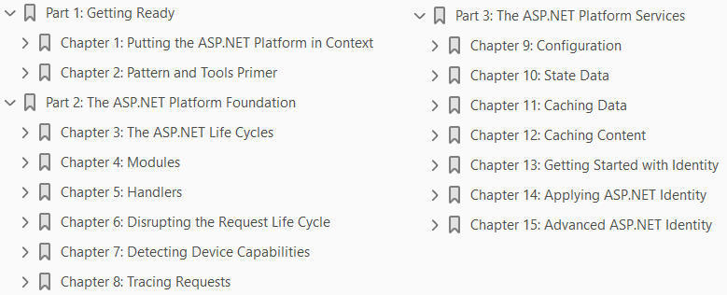

Slide 4
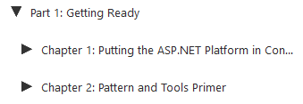
1
Putting the ASP.NET Platform in Context

Slide 5
Intro
The ASP.NET platform was originally developed for use with Web Forms, and support for the MVC framework was added later.
The ASP.NET platform is full of rich and useful features, but most guides to the MVC framework assumed that programmers have experience in Web Forms development and already know what the platform is capable of doing.
That was a reasonable assumption when the MVC framework was new, but a new generation of ASP.NET developers has jumped right in with MVC without using Web Forms and—by implication—the features that the ASP.NET platform provides.
The ASP.NET platform provides the necessary support for the MVC framework developer who has no Web Forms experience (and no desire to acquire any).
You don’t need to know how the ASP.NET platform works to build MVC framework applications, but you will want to know when you learn
just how much functionality is available and how it can help simplify application development
customize the way that the MVC framework operates
scale up applications to larger numbers of users, both for local and cloud-deployed applications.

Slide 6
NOTE
This book is not an MVC framework tutorial, and I assume you have a basic understanding of MVC and web application development in general.
If you are new to the MVC framework, then start by reading my Pro ASP.NET MVC 5 book, which is also published by Apress.

Slide 7
What is ASP.NET Platform?
ASP.NET was originally synonymous with Web Forms, which aims to make the web application development experience as similar as possible to developing a traditional desktop application and to abstract away the details of HTML and HTTP.
Web Forms has achieved remarkable market penetration despite having a reputation for producing hard-to maintain applications and being bandwidth hungry.
Microsoft continually improves and updates Web Forms—and it is still a widely used technology—but the broad development trend is away from abstraction and toward embracing the stateless nature of HTTP.
To remain current in the web development world, Microsoft extended ASP.NET to include the MVC framework and, more recently, SignalR and Web API.
These technologies have disparate natures.
The MVC framework is an alternative to Web Forms for building complete web applications.
SignalR uses an HTML5 feature called web sockets to enable real-time communication between a browser and a server.
Web API is used to create web services and APIs that deliver JSON or XML content.

Slide 8
ASP.NET Foundation
The ASP.NET technologies share some common characteristics, and this is where the ASP. NET platform starts to emerge.
Features that are common across ASP.NET-such as the need to receive and process HTTP requests, for example-are implemented in a common foundation, which results in the technology stack shown in Figure 1-1.
The dotted line in the figure illustrates that some of the design decisions made when Web Forms was the only ASP.NET technology are still present in the ASP.NET foundation.
For the most part, this just means that there are some odd method names in the foundation API.

Slide 9
ASP.NET Services
The ASP.NET platform doesn’t just provide common features to the ASP.NET technology stack; it also provides a set of services that make it easier to write web applications, such as
Security
State Data
Caching
as illustrated by Figure 1-2.
When using the MVC framework, you will usually consume these services from within controllers and models, but the services themselves are not part of the MVC framework and are available across the entire ASP.NET family of technologies.

Slide 10
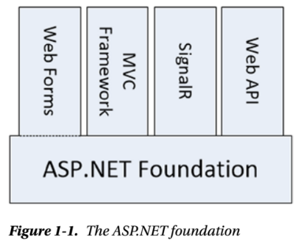
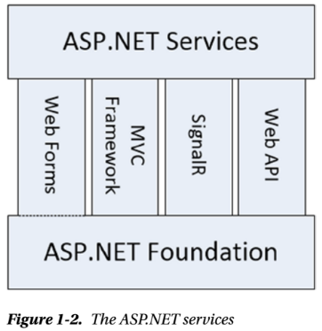
Figure 1-1 || 1-2

Slide 11
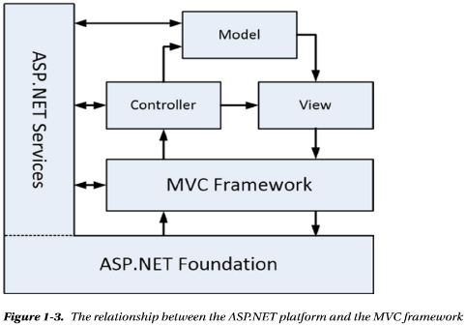
ASP.NET Platform & MVC: Relationship
In the Figure 1-3, the ASP.NET services is shown as being separate from the ASP.NET foundation, which makes them easier to describe but doesn’t accurately reflect the fact almost all of the services are integrated into the functionality provided by the foundation.
This is important because the services rely on the way that the foundation handles HTTP requests in order to provide functionality to services, and it will start to make more sense once you understand the details of the ASP. NET request life cycle.
The ASP.NET platform is the combination of the foundation and the services as illustrated by Figure 1-3.

Slide 12
What Do You Need to Know?
This book is for developers who have experience in web application development using C# and the MVC framework.
You should understand
the nature of HTTP
HTML
CSS
familiar with the basic features of Visual Studio 2013 (although I provide a quick primer for how I use Visual Studio in Chapter 2).
You will find this book hard to follow if you don’t have experience with the MVC framework, although there are plenty of examples that will help fill in the gaps.
If you need to brush up on using the MVC framework, then I suggest my Pro ASP.NET MVC 5 for MVC development and The Definitive Guide to HTML5 for detailed coverage of HTML and CSS.

Slide 13
What’s the Structure of This Book?
This book is split into three parts, each of which covers a set of related topics.
Part 1: Getting Ready
Part 1 of this book provides the information you need to get ready for the rest of the book.
It includes this chapter and a primer for the tools I use in this book and for the MVC pattern.
Part 2: The ASP.NET Platform Foundation
Part 2 of this book takes you through the foundation features of the ASP.NET platform, starting with the application and request life cycle and onto more advanced topics such as modules and handlers.
This part of the book explains in detail how the ASP.NET platform handles requests and passes them to the MVC framework.
Part 3: The ASP.NET Services
Part 3 of this book describes the services that the ASP.NET platform provides to developers for use in MVC framework applications.

Slide 14
What’s the Structure of This Book? |
These services range from hidden gems such as the configuration service to performance optimizations, such as data and content caching.
I also describe the new ASP.NET Identity system, which is used to manage user authentication and authorization.

Slide 15
Are There Lots of Examples?
There are loads of examples. I demonstrate every important feature with code examples that you can add to your own projects, and I list the contents of every file in every example so that you get a complete picture of how each feature works.
I use two code styles for examples.
The first is when I list a complete file, as shown in Listing 1-1.
This listing is taken from Chapter 13—don’t worry about what it does at the moment. I usually start the chapter with complete listings; then, as I make changes to show you different features, I switch to partial listings, such as Listing 1-2.
This listing is also taken from Chapter 13 and shows a section of the file from Listing 1-1.
I highlight the changes that I have made or the statements I want to draw your attention to.
Using partial listings helps avoid endless repetitions of files that have small changes and lets me pack in more examples per page and per chapter.

Slide 16
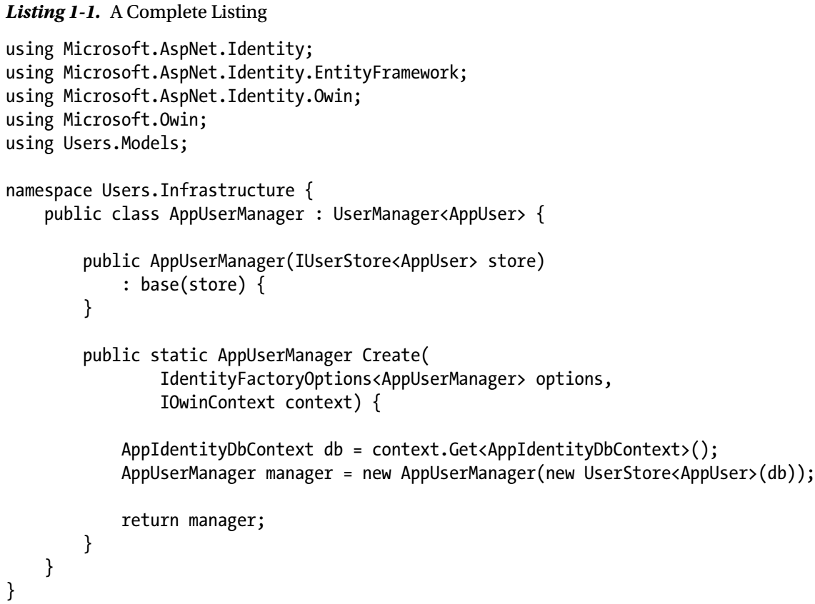
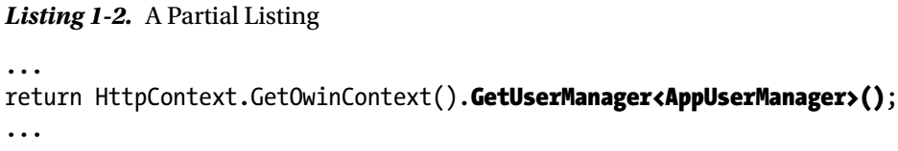
Listing 1-1 || 1-2

Slide 17
Where Can You Get the Example Code?
All of the example code is contained in the text of this book, but you don’t have to type it in yourself.
You can download a complete set of example projects, organized by chapter, without charge from Apress.com.

Slide 18
What Software Do You Need for This Book?
The most important software you need for this book is Visual Studio 2013, which contains everything you need to get started, including
a built-in application server for running and debugging MVC applications
an administration-free edition of SQL Server for developing database-driven applications
tools for unit testing
a code editor compiler and debugger
There are several editions of Visual Studio, but I will be using the one that Microsoft makes available free of charge, called Visual Studio Express 2013 for Web.
Microsoft adds some nice features to the paid-for editions of Visual Studio, but you will not need them for this book, and all of the figures that you see throughout this book have been taken using the Express edition, which you can download from www.microsoft.com/visualstudio/eng/products/ visual-studio-express-products.
There are several versions of Visual Studio 2013 Express, each of which is used for a different kind of development. Make sure that you get the Web version, which supports ASP.NET applications.
I follow a specific approach to creating ASP.NET projects:
I don’t use the predefined templates that Microsoft provides, preferring to explicitly add all of the packages that I require.

Slide 19
What Software Do You Need for This Book? |
This means more work is required to get set up, but the benefit is that you end up with a much better understanding of how an application fits together.
I provide a primer in Chapter 2 that gives an example of what you can expect.

Slide 20
TIP
Visual Studio includes NuGet for downloading and installing software packages.
I use NuGet throughout this book.
So that you are sure to get the results that I demonstrate, I always specify the version of the NuGet package you require.
If you are in doubt, download the source code for this book from www.apress.com, which contains complete projects for each chapter.

Slide 21
Preparing Visual Studio
Visual Studio Express contains all the features you need to create, test, and deploy an MVC framework application, but some of those features are hidden away until you ask for them.
To enable all of the features, select Expert Settings from the Visual Studio Tools ➤ Settings menu.
The only other preparation is to disable the Browser Link feature when you create projects.
Browser Link works by establishing a connection to the server that is used to receive notifications when the project contents change.
In Part 2 of this book, I spend a lot of time talking about how requests are handled, and the extra requests sent by Browser Link skew the results.
Disable Browser Link by clicking the button highlighted in Figure 1-4 and deselecting the Enable Browser Link menu item.

Slide 22
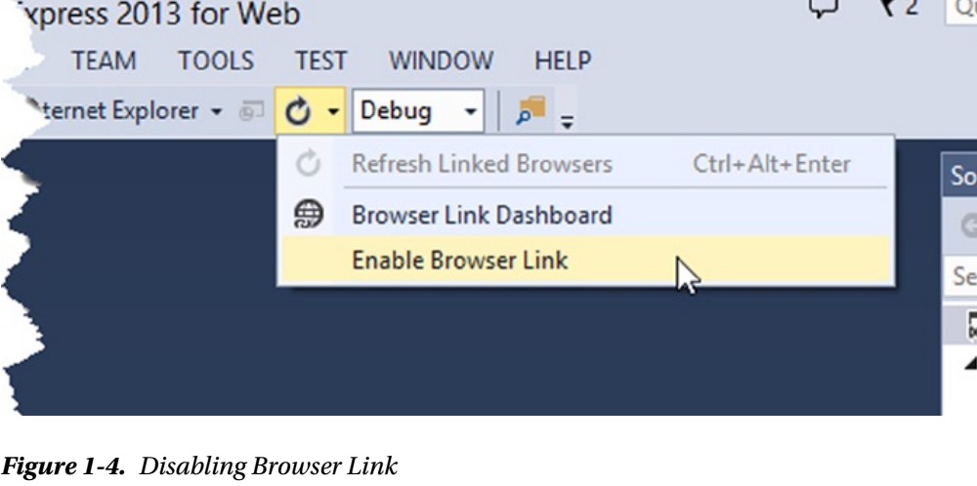
Figure 1-4

Slide 23
TIP
Microsoft has decided that the top-level menus in Visual Studio should be all in uppercase, which means that the menu I just referred to is really TOOLS.
I think this is rather like shouting, and I will capitalize menu names like Tools is here throughout this book.

Slide 24
Getting Google Chrome
For the majority of the examples in this book, I use Internet Explorer because I know that it is always available on Windows.
There are occasions when I use Google Chrome, and you will need to download it from www.google.com/chrome if you want to re-create the examples.
I use Chrome for two main reasons.
The first reason is because it supports simple emulation of mobile devices, which is useful in Chapter 7 when I show you how to detect device capabilities.
The second reason is when I show you how to differentiate requests for services like caching in Chapter 12.

Slide 25
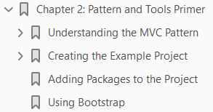
2
Pattern and Tools Primer

Slide 26
Intro
In this chapter, I provide a brief overview of the pattern that the MVC framework follows and demonstrate the process for creating a simple MVC project using Visual Studio 2013.
The purpose of this chapter is to refresh your memory about
the nature
Objectives
benefits of the MVC pattern
and to show you the process I use to create the examples in this book.
This chapter isn’t a tutorial for the MVC framework.
As I explained in Chapter 1, you already need to have a basic understanding of MVC framework development in order to benefit from the features and techniques I describe in this book.
If you do not have experience with the MVC framework, then read Pro ASP.NET MVC 5, also from Apress, before continuing.

Slide 27
Understanding the MVC Pattern
The term Model-View-Controller has been in use since the late 1970s and arose from the Smalltalk project at Xerox PARC where it was conceived as a way to organize early GUI applications.
Interactions with an MVC application follow a natural cycle of user actions and view updates, where the view is assumed to be stateless.
This fits nicely with the HTTP requests and responses that underpin a web application.
Further, the MVC pattern enforces a separation of concerns—the domain model and controller logic are decoupled from the user interface, which means that an MVC application will be split into at least three pieces:
Models, which contain or represent the data that users work with.
These can be simple view models, which just represent data being transferred between views and controllers
they can be domain models, which contain the data in a business domain as well as the operations, transformations, and rules for manipulating that data.
Views, which are used to render some part of the model as a user interface.

Slide 28
Understanding the MVC Pattern |
Controllers, which
process incoming requests
perform operations on the model
select views to render to the user

Slide 29
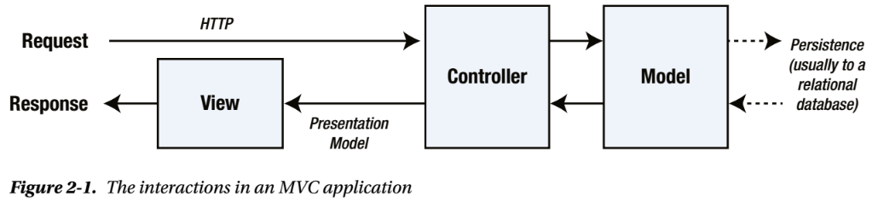
Interaction in MVC Application
In the MVC framework, controllers are C# classes derived from the System.Web.Mvc.Controller class.
Each public method in a class derived from Controller is an action method, which is associated with a URL defined through the ASP.NET routing system.
When a request is sent to the URL associated with an action method, the statements in the controller class are executed in order to perform some operation on the domain model and then select a view to display to the client.
Figure 2-1 shows the interactions between the controller, model, and view.

Slide 30
View Engine
The ASP.NET MVC framework use a view engine, which is the component responsible for rendering a view to generate a response for the browser.
The view engine for the MVC framework is called Razor, and you’ll see examples of Razor markup throughout this book.
If you don’t like Razor, then you can select one of the many third-party view engines that are available.

Slide 31
Models
Models are the definition of the universe your application works in.
In a banking application, for example, the model represents everything in the bank that the application supports, such as
Accounts
the general ledger
credit limits for customers
as well as the operations that can be used to manipulate the data in the model, such as depositing funds and making withdrawals from the accounts.
The model is also responsible for preserving the overall state and consistency of the data—for example, making sure that all transactions are added to the ledger and that a client doesn’t withdraw more money than he is entitled to or more money than the bank has.
The MVC framework doesn’t apply any constraints on the implementation of your domain model.
You can create a model using regular C# objects and implement persistence using any of the databases, object-relational mapping frameworks, or other data tools supported by .NET.

Slide 32
Controllers
Controllers are the bridge between views and the model;
requests come in from the client and are serviced by the controller,
which selects an appropriate view to show the user and,
if required, an appropriate operation to perform on the model

Slide 33
Understanding the Benefits of the MVC Pattern
The first benefit is scale, not in terms of how many users a web application can support but in terms of how complex it can be.
Technologies such as Web Forms can be used to build complex applications, of course, but doing so requires detailed planning and attention to detail, and many projects end up as a morass of code that duplicates functionality and markup in multiple places, making extending or fixing the application difficult.
Most developers produce MVC projects that can scale in complexity without much difficulty and that are easy to maintain and extend (and if you do find yourself in a mess, the separation of concerns in an MVC framework application makes it easier to refactor the application back onto a stable footing).
The second benefit is unit testing. The module nature of the MVC framework makes it easy to perform unit testing, aided by the testing support provided by Visual Studio (although many other testing toolkits are available).
The third benefit is flexibility. The separation of concerns makes it relatively easy to respond to changes in requirements throughout the life of the application.

Slide 34
Understanding Benefits of the MVC Pattern |
This is a hard benefit to quantify and comes in part from the MVC pattern and in part from the convention-over-configuration approach that the MVC framework has adopted, but once the fundamental pieces of an application have been developed, it is a simple task to modify or rearrange them to respond to requests in new ways.

Slide 35
Creating the Example Project
In this section, I am going to walk through the process of creating a simple MVC framework application.
Not only will this act as a quick primer for how Visual Studio supports MVC development, but it will also allow me to demonstrate the way that I like to create projects.
Visual Studio is set up to add default template content to most projects, but I prefer to start with a minimal project and explicitly add the features I require.
To get started, I created a new Visual Studio project. Select File ➤ New Project to open the New Project dialog window.
Navigate through the Templates section to select the Visual C# ➤ Web ➤ ASP.NET Web Application template and set the name of the project to SimpleApp.
Click the OK button to move to the New ASP.NET Project dialog window. Ensure that the Empty option is selected and check the MVC option.
Click the OK button, and Visual Studio will create a new project called SimpleApp.

Slide 36
Creating the MVC Components
I need three components to create an MVC framework application:
the model
the view
the controller.
Most projects start with the model, and for this example, I am going to create a simple model that is stored entirely in memory and is reset each time the application is restarted so that I don’t have to create and configure a database, although in a real project data persistence is usually required.

Slide 37
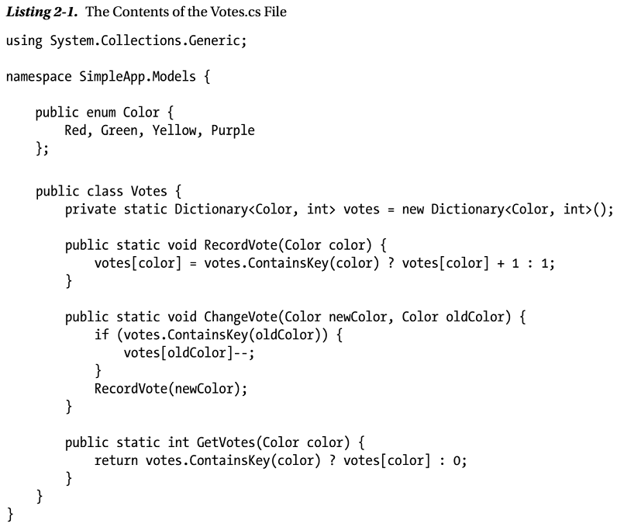
Listing 2-1

Slide 38
Model
Right-click the Models folder in the Visual Studio Solution Explorer and select Add ➤ Class from the pop-up menu.
Set the name to Votes.cs and click the Add button to create the class file. Edit the contents of the file to match those shown in Listing 2-1.
My example application will allow users to vote for their favorite color.
This isn’t an exciting demonstration, but it will provide me with a simple application that I can use to demonstrate where the ASP.NET framework stops and the MVC framework starts when I extend the project in later chapters.
I have defined an enum of colors that users can vote for and a Votes class that records and reports on the votes for each color.
The methods presented by the Votes class are static, and the data, which is stored in a dictionary collection, will be lost when the application is stopped or restarted.

Slide 39
Controller
The controller is the component that defines the logic for receiving HTTP requests from the browser, updating the model, and selecting the view that will be displayed to the user.
An MVC framework controller provides one or more action methods that are targeted by individual URLs.
The mapping between URLs and action methods is handled through the URL routing feature, and the default routing configuration specifies that requests to the default URL (the / URL) for the application are mapped to the Index action method in a controller called Home.
I am not going to get into the details of the URL routing system in this book, but the default configuration is sufficient for my example application as long as I create a controller with the right name.
Right-click the Controllers folder in the Visual Studio Solution Explorer and select Add ➤ Controller from the pop-up menu.
Select MVC 5 Controller – Empty from the list of options and click the Add button.
Set the name to be HomeController and click the Add button to create the Controllers/HomeController.cs file.
Edit the new file to match Listing 2-2.

Slide 40
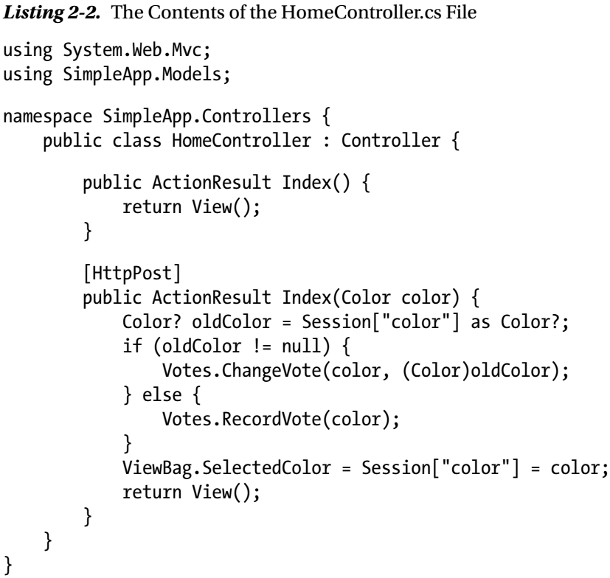
Listing 2-2

Slide 41
NOTE
Using static data and methods in the Votes class means I don’t have to use a technique called dependency injection to provide instances of Votes to application components that require them.
I wouldn’t use the static approach in a real project because dependency injection is a useful technique that helps create an easy-to-manage code base.
See my Pro ASP.NET MVC 5 book for details of setting up and using dependency injection.
For this chapter, I need a simple MVC application and don’t have to consider long-term maintenance or testing.
The URL routing system is actually part of the ASP.NET platform rather than the MVC framework, but I described URL routing in detail in my Pro ASP.NET MVC 5 book, and I am not going to repeat the information here.

Slide 42
Action Methods
One useful feature of controllers is the ability to define multiple action methods with the same name and then differentiate them through the use of attributes.
In the listing, I have applied the HttpPost attribute to the Index action method that takes an argument, which tells the MVC framework that the method should be used to handle HTTP POST requests.
HTTP GET requests will be handled by the Index method that takes no arguments.
The goal of an action method is to update the model and select a view to be displayed to the user.
I don’t need to update my model when dealing with GET requests, so I just return the result from calling the View method, which selects the default view associated with the action method.
I need to update the vote tally when dealing with POST requests, either by registering a new vote or, if the user has voted already, by changing an existing vote.
I keep track of whether a user has voted through the Session property, which allows me to maintain state data for the duration of the user’s browser session.

Slide 43
View
The final component is the view, which generates the HTML that is displayed to the user as the response to an HTTP request.
Both of the action methods in the Home controller call the View method without any arguments, which tells the MVC framework to look for a view whose name matches the action method name.
The MVC framework will search for an Index view with different file extensions and in different folder locations, one combination of which is /Views/Home/Index.cshtml.
The Views folder is the conventional location of views in an MVC application, the Home folder is the conventional location for views used by the Home controller, and the .cshtml file extension specifies that the view contains C# Razor annotations.
To create the view for the example application, right-click either of the action methods in the HomeController class and select Add View from the pop-up menu to open the Add View dialog window.
Set the Name field to Index, set the Template field to Empty (without model), and ensure that the Create as a partial view and Use a layout page options are not checked, as shown in Figure 2-4.
Click the Add button, and Visual Studio will create a file called Index.cshtml in the Views/Home folder. Edit this file so that it matches Listing 2-3.

Slide 44
View |
An MVC framework view uses a combination of standard HTML elements and Razor annotations to dynamically generate content.
I am using a single view to response to HTTP GET and POST requests, so some of the Razor annotations adapt the content to reflect whether the user has already voted; the other annotations generate HTML elements based on the enumeration of colors and the total number of votes.

Slide 45
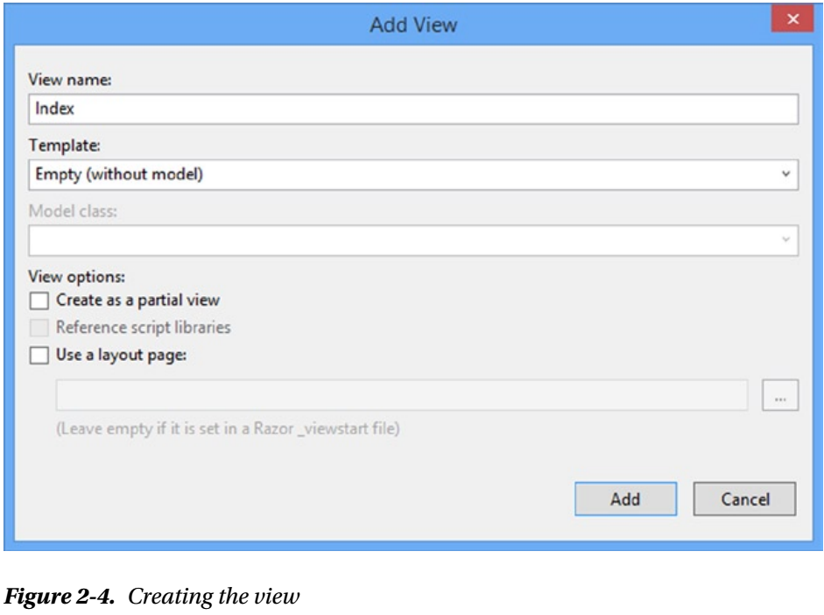
Figure 2-4

Slide 46
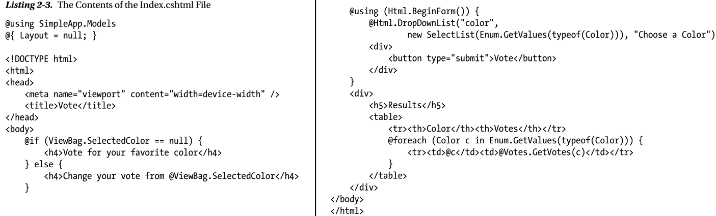
Listing 2-3

Slide 47
Testing the Application
Once you have created the three components in the previous section, you can test them by selecting Start Debugging from the Visual Studio Debug menu.
Visual Studio will open a browser window and navigate to the application URL, allowing you to select a color and vote.
Figure 2-5 illustrates the voting process.

Slide 48
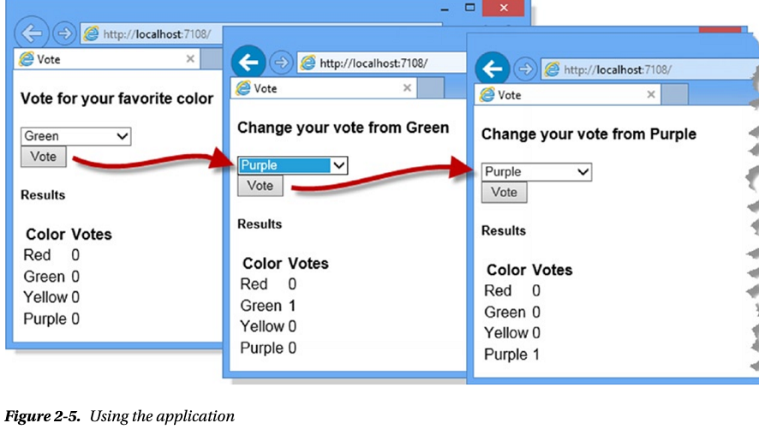
Figure 2-5

Slide 49
Adding Packages to the Project
As I explained earlier in the chapter, I prefer to create a basic Visual Studio project and then explicitly add the features I need.
This is less work than you might expect because Visual Studio supports NuGet, which is a package manager that provides access to a wide catalog of packages for .NET application development.
The integration into Visual Studio allows for the
automatic downloading
Installation
dependency management of packages
has transformed the process of using standard libraries in .NET development.
The NuGet package catalog, which you can browse at www.nuget.org, is extensive and includes many popular open source web application packages.
Microsoft has given tacit support to some of these packages by including them in the Visual Studio templates for new ASP.NET projects, but you can use NuGet directly to install these packages without getting the rest of the (generally useless) template content.
One package that Microsoft has adopted with the MVC 5 release is Bootstrap, which is an excellent CSS and JavaScript library for styling HTML that grew out of a project at Twitter.

Slide 50
Adding Packages to the Project |
I have absolutely no design skills at all, and I like using Bootstrap because it lets me style content during the early stages of development without making too much of a mess.
I like to work with professional designers on real projects (and I recommend you do the same), but in this book I’ll use Bootstrap to make some the examples easier to understand and to highlight specific results and features.
I’ll show you how I use Bootstrap later in this chapter, but in this section I will show you how to use the Visual Studio support for NuGet to download and install the Bootstrap package.

Slide 51
NuGet
Visual Studio provides a graphical interface that lets you navigate through the package catalog, but I prefer to use the console feature that accepts NuGet commands directly in Visual Studio.
Open the console by selecting Package Manager Console from the Tools ➤ Library Package Manager menu and enter the following command:
The Install-Package command instructs Visual Studio to add a new package to the project.
When you press the Enter key, Visual Studio will download and install the Bootstrap package and any other packages that it depends on.
Bootstrap depends only on the popular jQuery library, which Visual Studio added automatically when setting up the project, along with some additional JavaScript files that use jQuery to handle form validation.
The Bootstrap NuGet package adds some CSS files to the Content folder (which is the home of static content in an MVC framework application) and some JavaScript files to the Scripts folder.
Bootstrap mainly works through CSS files, but there are some JavaScript enhancements for more complex interactions. (The Bootstrap package also creates a fonts folder. Not all open source libraries fit neatly into the ASP.NET project structure, so occasionally you will see artifacts like this to support assumptions made by the library about the layout of its files.)

Slide 52
TIP
The -version argument allows me to specify a particular version of the package, and version 3.0.3 is the current version of Bootstrap available as I write this.
The latest version of the package will be installed if you omit the –version argument when using the Install-Package command.
I use specific versions of packages in this book to ensure that you are able to re-create the examples.

Slide 53
NOTE
Bootstrap is only one of the packages that Microsoft has adopted, and I only briefly describe its use in this chapter.
For full details of client-side development for MVC framework projects, see my Pro ASP.NET MVC 5 Client Development book, which is published by Apress.
Bootstrap isn’t directly related to the MVC Framework or the ASP.NET platform.
In this chapter I use it to demonstrate how to install a NuGet package and in later chapters to make the examples easier to follow.
If you are familiar with NuGet and Bootstrap (or are not interested in either), then you can move directly to Part 2 of this book, where I turn to the details of the ASP.NET platform.

Slide 54
Using Bootstrap
I don’t want to get into too much detail about Bootstrap because it isn’t the topic of this book, and I will be using it only to make the examples easier to understand.
To demonstrate the basic Bootstrap features, I have applied some of the most useful styles to the Views/Home/Index.cshtml file, as shown in Listing 2-4.
The first changes in the view are the addition of link elements to import the bootstrap.min.css and bootstrap-theme.min.css files into the HTML document.
Bootstrap includes a set of base CSS classes that are supplemented by replaceable themes.
The base classes are in the bootstrap.min.css file, and I have used the default theme that is defined by the bootstrap-theme.min.css file and that is installed by the NuGet package.
The other changes apply the Bootstrap CSS classes to style the HTML content that the view will generate.
Bootstrap includes a lot of CSS classes, and I am only using some of the most basic, but they are representative of the examples you will see throughout this book.
Figure 2-6 shows the effect that the changes in Listing 2-4 have on the application, which will provide some useful context.

Slide 55
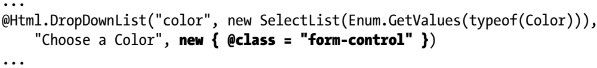
Using Bootstrap |
I am not going to describe the individual Bootstrap classes in detail, but I have provided a quick summary of those that I have used in Listing 2-4 in Table 2-1 so that you can see how I created the effect shown in the figure.
The Bootstrap classes are simple to use and can quickly create a consistent layout for the HTML in a view.
For the most part, I applied the classes to the static HTML elements in the view in Listing 2-4, but I have also used a Bootstrap class with the HTML helper method that generates the select element from the enumeration of color values, like this:

Slide 56
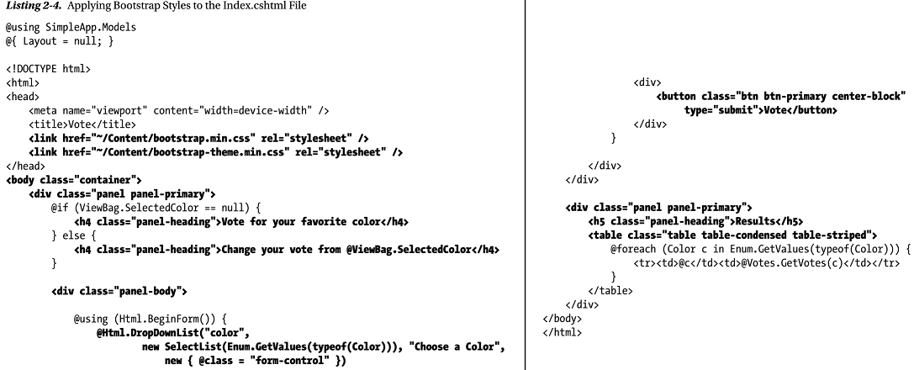
Listing 2-4

Slide 57
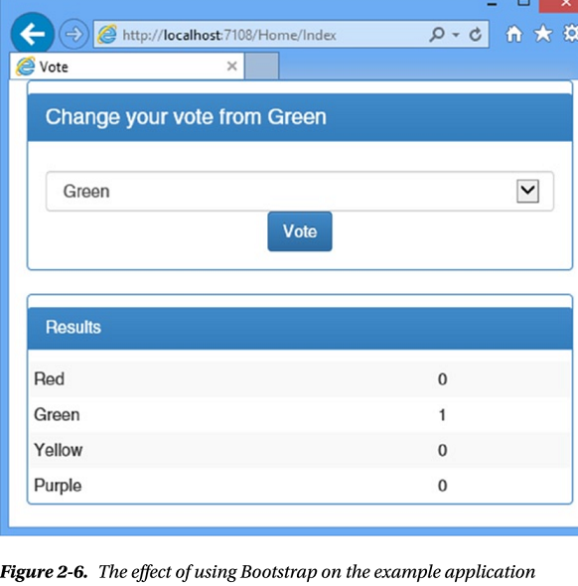
Figure 2-6

Slide 58
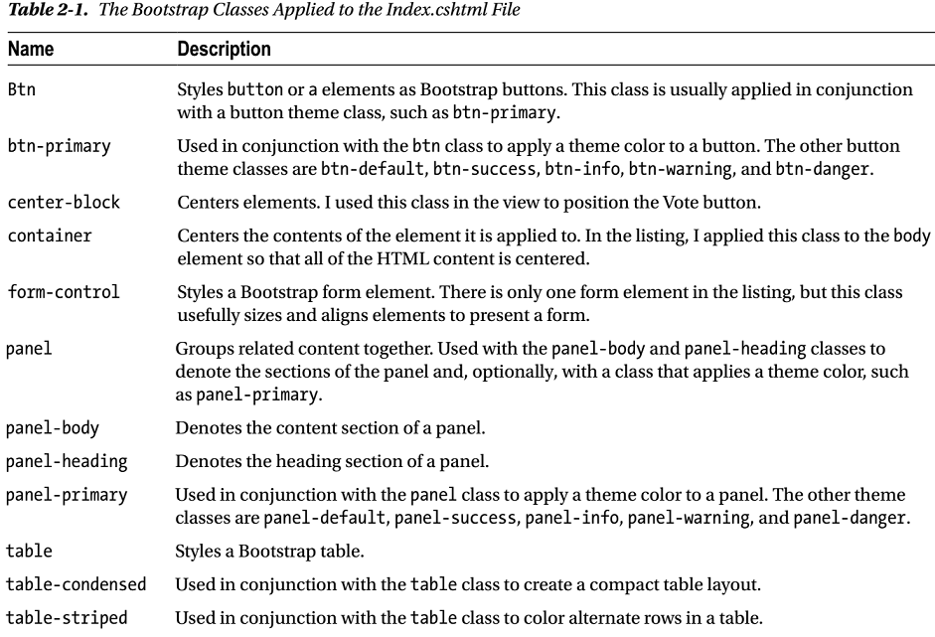
Table 2-1

Slide 59
TIP
I am using the minified versions of the Bootstrap files in this example, which have been processed to remove whitespace, comments, and other optional content.
Minified files are used in deployment to reduce bandwidth requirements or (as here) when using third-party packages that you do not need to debug.
The NuGet package also installs the human-readable files if you want to take a look at how Bootstrap works.
Bootstrap functionality is largely provided through CSS classes but is supplemented with some JavaScript additions.
I don’t need to use the JavaScript features for this example and am only using the CSS classes.
I have to prefix the property name with @ because class is a C# keyword.
The @ symbol is a standard C# feature that allows the use of keywords without confusing the compiler.

Slide 60
HTML Helpers
The HTML helpers are convenience methods used in Razor views to generate HTML elements from model data.
All of the helper methods are overridden so that there is a version that accepts an object that is used to apply attributes to the elements that are created.
The properties of the object are used for the attribute names, and the values for the attributes are taken from the property values.
For the DropDownList helper in the example, I have passed in a dynamic object that defines a class property that applies the Bootstrap form-control class to the select element that the helper creates.

Slide 61
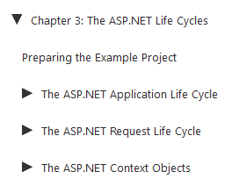
3
ASP.NET Life Cycle

Slide 62
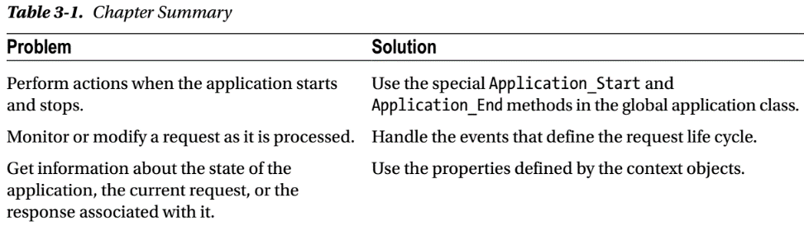
Intro
The ASP.NET platform defines two important life cycles that underpin the MVC framework.
The first is the application life cycle, which tracks the life of a web application from the moment it starts to the moment it is terminated.
The second is the request life cycle, which defines the path that an HTTP request follows as it moves through the ASP.NET platform from the point at which the initial request is received until the response is sent.

Slide 63
Preparing the Example Project
For this chapter, I am going to continue use the SimpleApp project I created in Chapter 2 and that allows the user to vote for a color.
You will find that most of the MVC framework applications that I build in this book are pretty simple because my focus is on the ASP.NET platform.

Slide 64
The ASP.NET Application Life Cycle
As an MVC framework developer, you are used to starting an application and letting it handle requests, using Visual Studio during development or on a production platform after deployment.
At some later time, the application is stopped—perhaps for maintenance or an upgrade—and requests are no longer processed.
These two moments—the point at which an application starts and stops receiving requests—define the application life cycle, the management of which provides the most fundamental features for ASP.NET web applications.
ASP.NET provides notifications when the application starts and when it is stopped in a controlled way.
Table 3-2 puts the application life-cycle notifications in context.

Slide 65
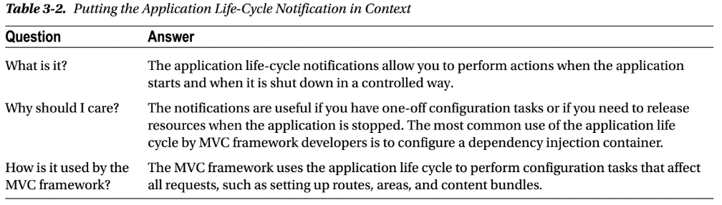
Table 3-2

Slide 66
Understanding the Application Life Cycle
The life cycle of an ASP.NET application begins the moment the application is started and continues while HTTP requests are received from clients and processed to generate responses.
It includes matching requests to controllers and actions and rendering content from Razor views.
The life cycle ends when the application is stopped.
The ASP.NET platform provides notifications of the two stages of the life cycle through methods defined by the global application class.

Slide 67
Global Application Class
The global application class has been around since the earliest versions of ASP.NET and consists of two files: Global.asax and Global.asax.cs.
Strictly speaking, the Global.asax file is the global application class, and the Global.asax.cs file is the associated code-behind file.
This is the classic Web Forms approach to splitting declarative and programmatic code and is an artifact of the origins of ASP.NET.
The Global.asax file used to be more important in ASP.NET applications, but it is just there for compatibility these days, even in Web Forms projects and you will never need to edit this file for an MVC framework project.
Listing 3-1 shows the content of the Global.asax file from the example project.

Slide 68
Global Application Class |
This is an example of a Web Forms directive that tells ASP.NET that the associated code file is called Global.asax.cs and that it is written in C#.
Listing 3-2 shows the contents of the Global.asax.cs file that Visual Studio created for the example project.
The default global application class is called MvcApplication and is derived from the System.Web.HttpApplication class.
We will come across more classes from the System.Web namespace it is the home of the bulk of the ASP.NET platform functionality.
The MvcApplication class is instantiated by the ASP.NET framework, and the methods it defines are called at key moments in the application life cycle.
The default implementation of the MvcApplication class contains only one method, called Application_Start.

Slide 69
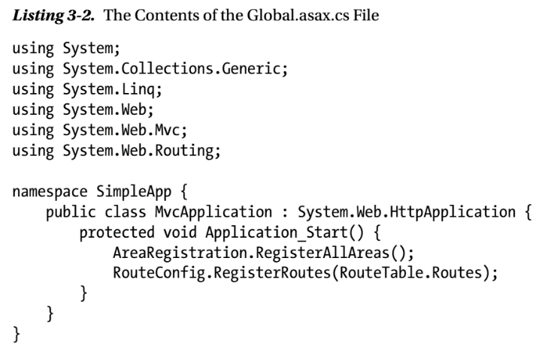
Listing 3-2

Slide 70
Receiving Notifications: Application Start & End
The global application class supports two special methods that define the start and end of the application life cycle, as shown in Table 3-3.
The Application_Start method is called when the application is first started and provides an opportunity to perform one-off configuration tasks that affect the entire application.
In Listing 3-2, you can see that Visual Studio has added statements to the Application_Start method that set up MVC areas and URL routes.
When I created the example project in Chapter 2, I selected the option for the minimal initial project content, but additional statements would have been added to the Application_Start method if I had selected one of the other template options.
The Application_End method is called just before the application is terminated and is an opportunity to release any resources that the application maintains and to generally tidy up.
The usual reason given for using this method is to release persistent database connections, but most modern web applications don’t manage connections directly, and I rarely find it necessary to implement the Application_End method in my own projects.

Slide 71
Receiving Notifications: Application Start & End |
Databases are pretty good at managing their own connections these days, which is good because the Application_End method is called only when the application is shut down in an orderly manner.
I refer to these methods as being special because they are implemented in an odd way.
These methods are not defined by the base for the global application class (which is System.Web.HttpApplication), so you don’t have to use the override keyword to implement them.
In fact, the ASP.NET framework uses reflection to look for the methods by name.
You won’t receive an error if you mistype the method names;
ASP.NET just assumes you don’t want to be notified when the application starts or stops.
For this reason, it is important to ensure that you test that your code is being called.
Calls to the Application_Start and Application_End methods bookend the life cycle of the application, and between those method calls ASP.NET receives and processes requests, as described in Figure 3-1.

Slide 72
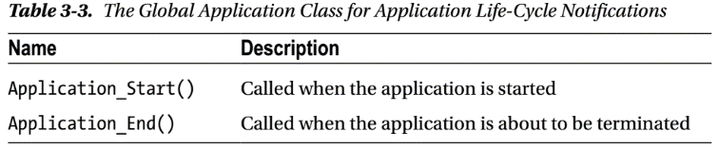
Table 3-3

Slide 73
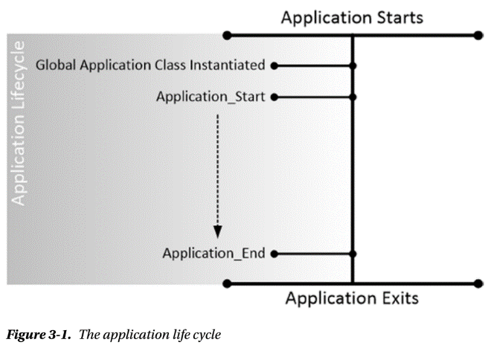
Figure 3-1

Slide 74
Testing the Start and Stop Notifications
You can use the Application_Start and Application_End methods directly in your applications to perform one-off startup and shutdown activities, just as the MVC framework does.
The simplest way to check that these methods are being called is to use the Visual Studio debugger.
In Listing 3-3 you can see how I have added calls to the static System.Diagnostics.Debugger.Break method to the Application_Start and Application_End methods, which has the same effect as setting a breakpoint using the Visual Studio code editor, but with the benefit of ensuring that you will get the same result I describe here if you re-create this example.

Slide 75
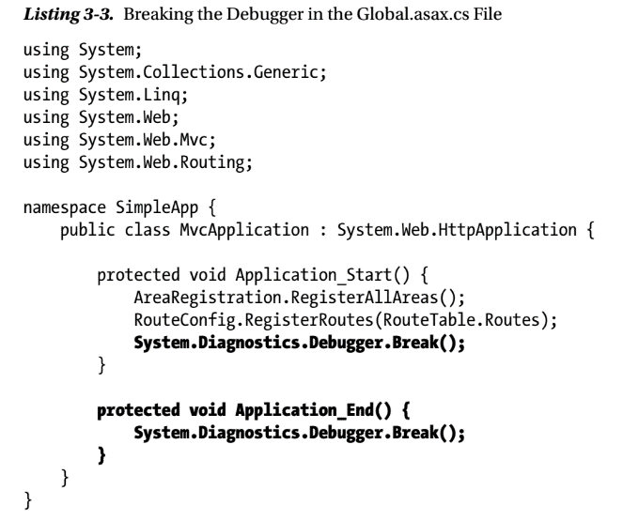
Listing 3-3

Slide 76
Testing the Start Notification
Testing the Application_Start method is simple.
Select Start Debugging from the Visual Studio Debug menu, and Visual Studio will open a browser window.
The ASP.NET framework begins initializing the application, creates an instance of the global application class, discovers the Application_Start method, and invokes it, which leads to the Break method being called.
The execution of the application is halted, and control is passed to the debugger, as shown in Figure 3-2.
Select Continue from the Visual Studio Debug menu, and execution of the application will resume.
The request from the browser is processed, generating an HTML response that allows the user to vote for a color.

Slide 77
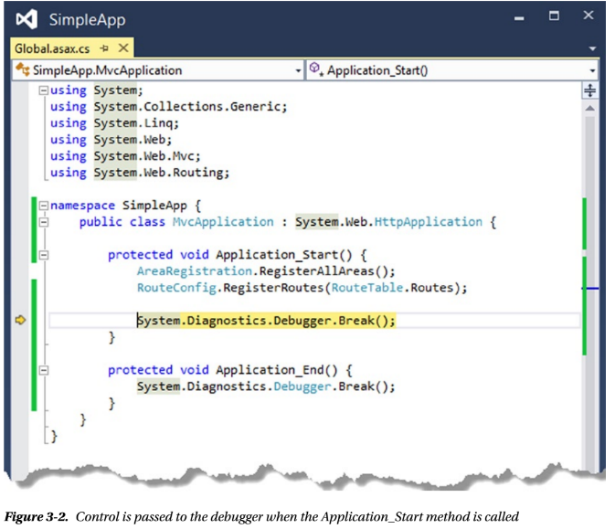
Figure 3-2

Slide 78
Testing the Stop Notification
Testing the Application_End method is a little trickier because selecting Stop Debugging detaches the debugger from the application before the Application_End method is called.
The browser window is closed, the debugger is terminated, and Visual Studio returns to its default state—but the Debugger.Break method isn’t invoked.
To test the code in the Application_End method, you must work with IIS Express directly, rather than through Visual Studio.
Execution of the application will continue, and the time and day of the week will be displayed by the browser.
Locate the IIS Express icon on the Windows taskbar and right-click to make the pop-up menu appear.
You will see a menu item for the SimpleApp project, and when you select it, you will see a Stop Site menu item, as shown in Figure 3-3.
When you select Stop Site, IIS Express will stop the application, and as part of this process, the Application_End method will be called.
For my example, this means the Debugger.Break call is executed, as shown in Figure 3-4.

Slide 79
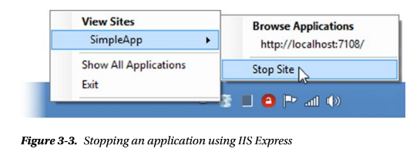
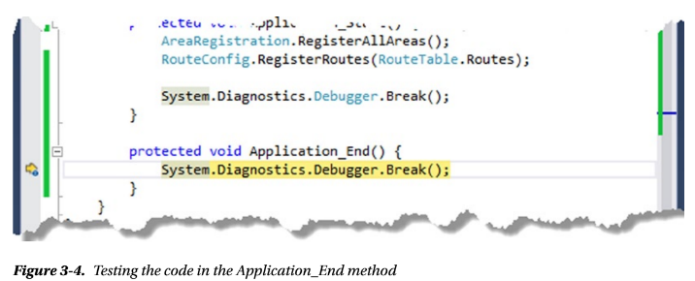
Figure 3-3 || 3-4

Slide 80
The ASP.NET Request Life Cycle
The global application class is also used to track the life cycle of individual requests, allowing you to follow each request as it
passes through the ASP.NET platform into the MVC framework.
The ASP.NET framework creates instances of the MvcApplication class defined in the Global.asax.cs file and uses the events it defines to shepherd the request through until the point where the response is generated and sent back to the browser.
These events are not just for use by the application developer
they are used by the ASP.NET framework and
the MVC framework to perform request handling
Table 3-4 puts the request life cycle in context.

Slide 81
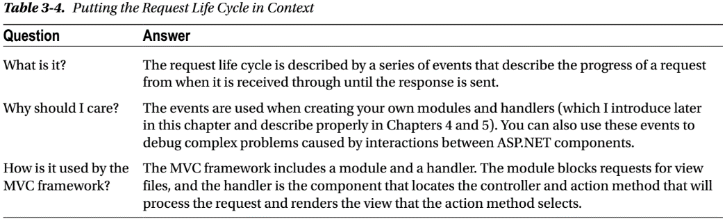
Table: 3-4

Slide 82
Understanding the Request Life Cycle (RLC)
The Application_Start and Application_End methods are not called on the MvcApplication instances that ASP.NET creates to handle requests.
Instead, the ASP.NET framework triggers the sequence of events described in Table 3-5.
These events describe the request life cycle.
The ASP.NET framework triggers these events to chart the path of a request through the processing life cycle.
You can handle these events
in the global application class
in a module or
in a handler
I introduce modules and handlers in the following section and describe them in depth in Chapters 4 and 5.

Slide 83
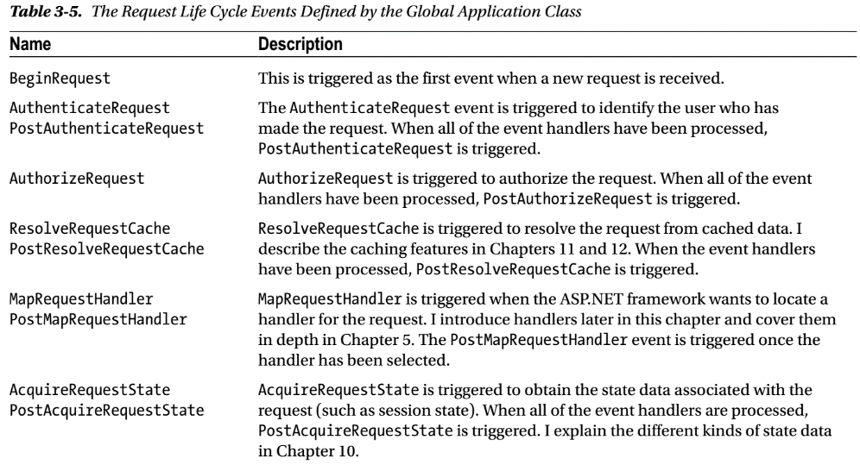
Table 3-5

Slide 84
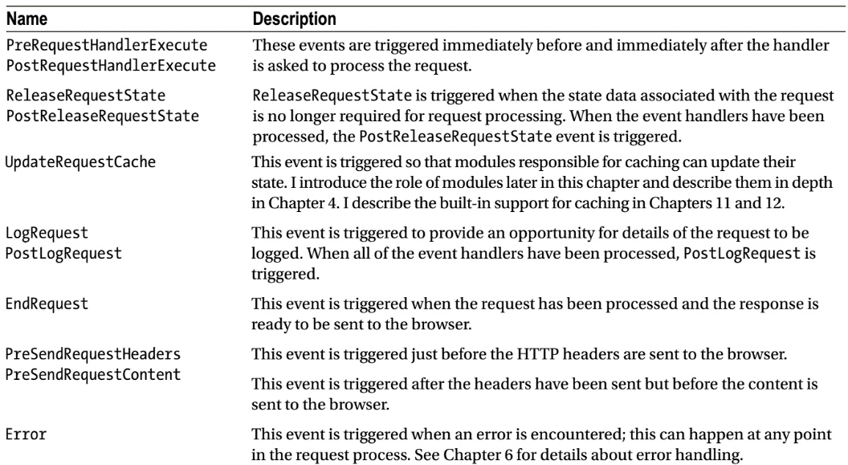
Table 3-5 |

Slide 85
LIFE OF A RLC HTTPAPPLICATION OBJECT
The ASP.NET framework will create multiple instances of the MvcApplication class to process requests, and these instances can be reused so that they process several requests over their lifetime.
The ASP.NET framework has complete freedom to create MvcApplication instances as and when they are required and to destroy them when they are no longer needed.
This means your global application class must be written so that multiple instances can exist concurrently and that these instances can be used to process several requests sequentially before they are destroyed.
The only thing you can rely on is that
each instance will be used to process one request at a time
meaning you have to worry only about concurrent access to data objects that are shared

Slide 86
Understanding Modules and Handlers
In the following sections, I show you how to respond to the request life-cycle events directly in the global application class.
This is a good start for exploring the life-cycle events, but it is suitable for only the simplest of interactions with requests.
Any serious request handling functionality tends to consume a number of life-cycle events, which means that the global application class quickly becomes a morass of code that handles the same events to handle requests in different ways.
The ASP.NET framework deals with this by supporting modules, which are self-contained classes that receive the life-cycle events and can monitor and manipulate requests.
Many of the most important ASP. NET platform services rely on the module functionality to prepare a request early in its life cycle.
Examples are the state data and security services, which include modules that respond to events such as AcquireRequestState and AuthenticateRequest to add data to a request before it is handled by the MVC framework.

Slide 87
Understanding Modules and Handlers |
Modules can interact with requests—and the associated responses—at any point in the life cycle, and I describe them in detail in Chapter 4.
The ASP.NET framework also supports a component called a handler.
Handlers are responsible for generating a response for a request.
The handler for the MVC framework is the component responsible for locating a controller and action method to service a request and rendering the view that the action method specifies.
The ASP.NET framework supports multiple handlers, which is why it is possible to mix and match development frameworks such as MVC, Web API, and Web Forms within the same application.
The handler is linked to four of the request life-cycle events.
The MapRequestHandler and PostMapRequestHandler events are triggered before and after a handler is selected for the request, and the PreRequestHandlerExecute and PostRequestHandlerExecute events are triggered before and after the handler is asked to generate a response for the request.
I describe how handlers work in detail in Chapter 5.

Slide 88
Understanding Modules and Handlers |||
The reason that I have introduced modules and handlers in this chapter is because doing so allows me to illustrate the request life cycle more completely, as shown in Figure 3-5.
Don’t worry if this seems complex; it will start to make sense as I explain how these events are handled and as you see how various ASP.NET platform services are implemented.
Notice that the global application class is instantiated by both the application and request life cycles.
Not only does the ASP.NET framework create multiple instances to service parallel requests, but it also creates separate instances to support each life cycle.
You will see the practical impact of this in the “Handling Property Exceptions” section later in this chapter.

Slide 89
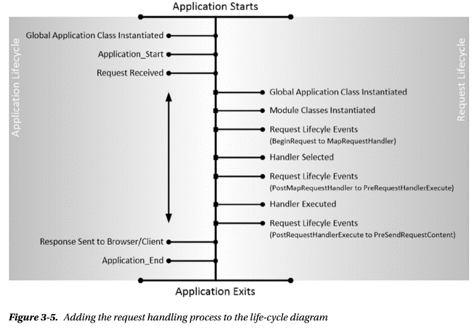
Figure 3-5

Slide 90
Handling Request Life-Cycle Events :Special Methods
To handle these events in the global application class, you create a method with a name that starts with Application_, followed by the event name, such as Application_BeginRequest, for example.
As with the Application_Start and Application_End methods, the ASP.NET framework finds the methods and invokes them when the event they correspond to is triggered.
In Listing 3-4, you can see how I have updated the global application class so it handles some of the events in the table (and removed the statements that cause the debugger to break).
I have defined a method called RecordEvent that accepts the name of an event and stores it using one of the ASP.NET state management features.
I describe these features in detail in Chapter 10, but the one I have used in this example—accessed via the Application property of the HttpApplication class—stores data in a way that makes it available throughout the application.
I call the RecordEvent method from three other methods I added to the global application class.
These events will be called when the BeginRequest, AuthenticateRequest, and PostAuthenticateRequest events are triggered.

Slide 91
Handling Request Life-Cycle Events:Special Methods |
I don’t have to explicitly register these methods as event handlers; the ASP.NET framework locates and invokes these methods automatically.

Slide 92
Displaying the Event Information
To display information about the events that my code receives, I need to make changes to the Home controller and its Index view.
In Listing 3-5, you can see how I retrieve the event state data and pass it to the view as the model object in the Home controller.
To access the data I stored in the global application class, I have to use the HttpContext.Application property, which I describe later in this chapter as part of the context objects that the ASP.NET framework provides and whose functionality I describe in Chapter 10.
In Listing 3-6, you can see how I have updated the Razor view associated with the controller so that details of the events are displayed in the browser.
The list of event names is passed to the view as the model object, and I use a Razor foreach loop to generate rows in an HTML table element.
The result is that the view generates HTML that describes the events that have been recorded by the global application class, as shown in Figure 3-6.

Slide 93
TIP
This technique can be used only for events up to PreRequestHandlerExecute in the sequence shown in Table 3-5.
This is because the action method in the controller is called between the PreRequestHandlerExecute and PostRequestHandlerExecute events and so subsequent events are triggered after the response has been produced.

Slide 94
Handling Request LC Events - Without Special Methods

Slide 95
The ASP.NET Context Objects
ASP.NET provides a set of objects that are used to provide context information about the current request, the response that will be returned to the client, and the web application itself; indirectly, these context objects can be used to access core ASP.NET framework features.
Table 3-8 summarizes the context objects.
The class at the heart of the context is System.Web.HttpContext.
It is universally available throughout the ASP.NET framework and the MVC framework, and it acts as a gateway to other context objects and to ASP.NET platform features and services.
In fact, the HttpContext class is so central to the ASP.NET framework that the most important properties are like a map to understand various related topics, as Table 3-9 illustrates.
The HttpContext class also defines methods and properties that can be used to manage the request life cycle—like the CurrentNotification and IsPostNotification properties.
Table 3-10 summarizes the ways in which you can get an HttpContext object in the different parts of an application.
A new set of context objects is created for every request, and when you obtain HttpRequest or HttpResponse objects, you will receive the instances that relate to the request being processed by the current instance of the global application class.

Slide 96
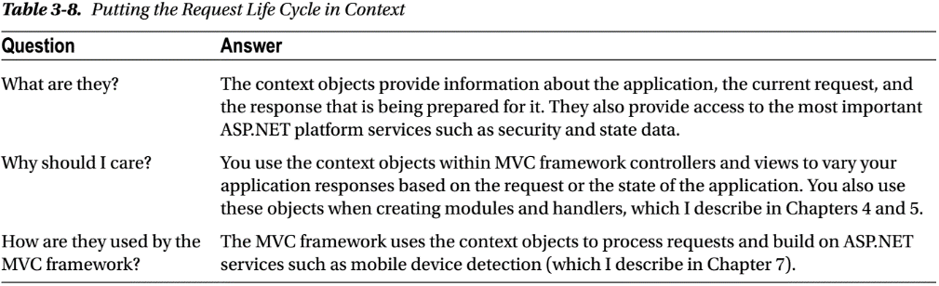
Table 3-8

Slide 97
Understanding the ASP.NET Context Objects
The class at the heart of the context is System.Web.HttpContext.
It is universally available throughout the ASP.NET framework and the MVC framework, and it acts as a gateway to other context objects and to ASP.NET platform features and services.
In fact, the HttpContext class is so central to the ASP.NET framework that the most important properties are like a map to understand various related topics, as Table 3-9 illustrates.
The HttpContext class also defines methods and properties that can be used to manage the request life cycle—like the CurrentNotification and IsPostNotification properties.
Table 3-10 summarizes the ways in which you can get an HttpContext object in the different parts of an application.
A new set of context objects is created for every request, and when you obtain HttpRequest or HttpResponse objects, you will receive the instances that relate to the request being processed by the current instance of the global application class.
In the Table 3-10, Model is not included, You can obtain the HttpContext object for the current request in the model through the static HttpContext.Current property, but I suggest that you don’t because it blurs the separation of concerns between the model and the controller.

Slide 98
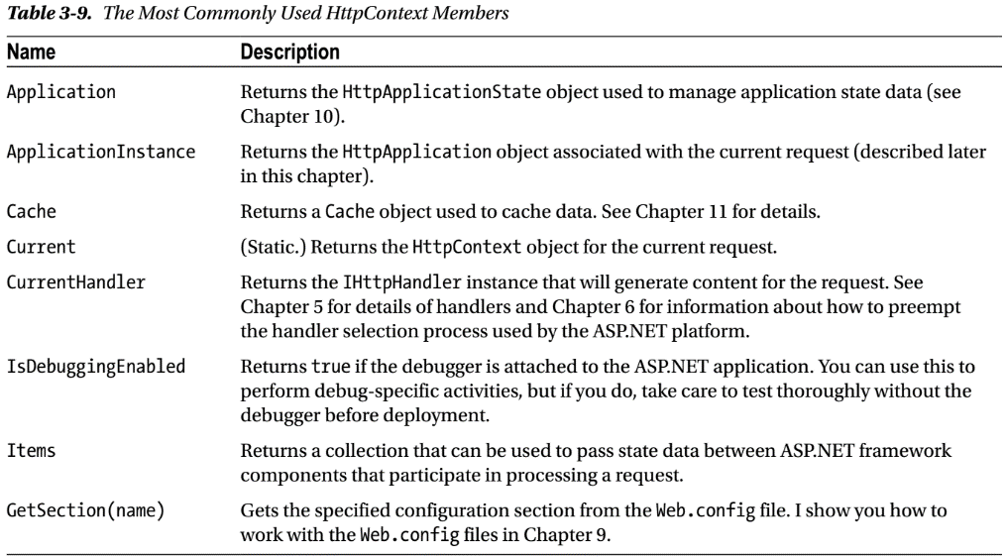
Table 3-9

Slide 99
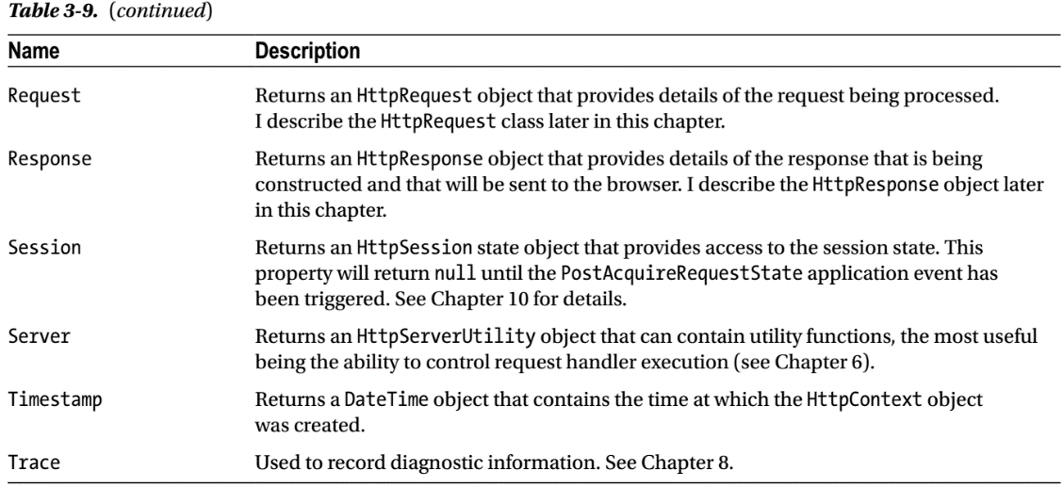
Table: 3-9 |

Slide 100
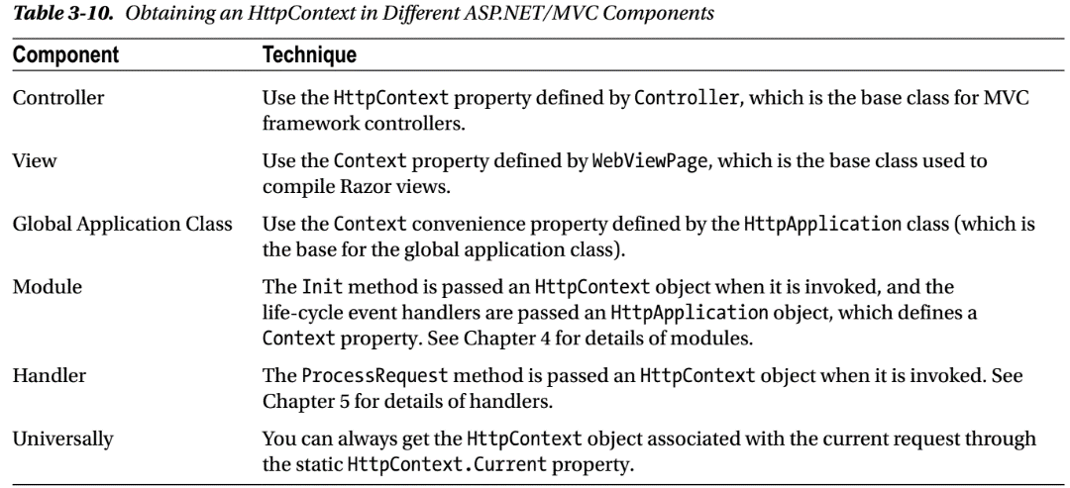
Table: 3-10

Slide 101
Context, Base and Wrapper Classes
The properties listed in Table 3-10 do not all return the same type.
The properties used in the pre-MVC framework components (the global application class, handlers, and modules) return an HttpContext object, just as you would expect).
These context objects predate the MVC framework and make it hard to perform unit testing because they are tightly coupled, requiring you to create entire sets of context objects each time you want to perform a test.
The properties defined by the MVC framework components—the controller and the view—are used to get context objects and return instances of different classes that are derived from the context classes but provide support for easy unit testing.
The HttpContext property in the Controller class returns an instance of the HttpContextBase class. All the context objects are represented by a class with Base appended to the name (HttpRequestBase, HttpResponseBase, and so on) and can more readily instantiated, configured, and mocked for testing purposes.
You will sometimes need to create a Base object from an ASP.NET object; for example, you might have an HttpRequest object but need to call a method that takes an HttpRequestBase object.

Slide 102
Context, Base and Wrapper Classes |
The ASP.NET class library includes classes with Wrapper appended to the name: HttpContextWrapper, HttpRequestWrapper, and so on.
These classes are derived from the Base classes and are used by the MVC framework to present the ASP.NET context classes in an MVC-friendly Base class (so HttpContextWrapper is derived from HttpContextBase, which accepts an instance of HttpContext as constructor arguments).
The Wrapper class constructors take context objects as arguments and the properties, and methods of the HttpContextWrapper are passed to the HttpContext instance that it contains.
You can’t unwrap a Base object—converting from HttpRequestBase to HttpRequest, for example.
But you can always get the context object you require through the static HttpContext.Current property, which returns an HttpContext object that presents the properties shown in Table 3-9.
You will have to use the fully qualified name for this property (System.Web.HttpContext.Current) within controller classes because they define an HttpContext property that returns an HttpContextBase object.

Slide 103
Working with HttpApplication Objects
Many of the classes that you will use in the ASP.NET framework provide convenience properties that are mapped to those defined by the HttpContext class.
A good example of this overlap can be seen in HttpApplication, which is the base for the global application class.
In Table 3-11, you can see the properties and methods defined by the HttpApplication class, many of which are similar to those defined by HttpContext.
Most of these members are convenience properties that map to the properties of the HttpContext class.

Slide 104
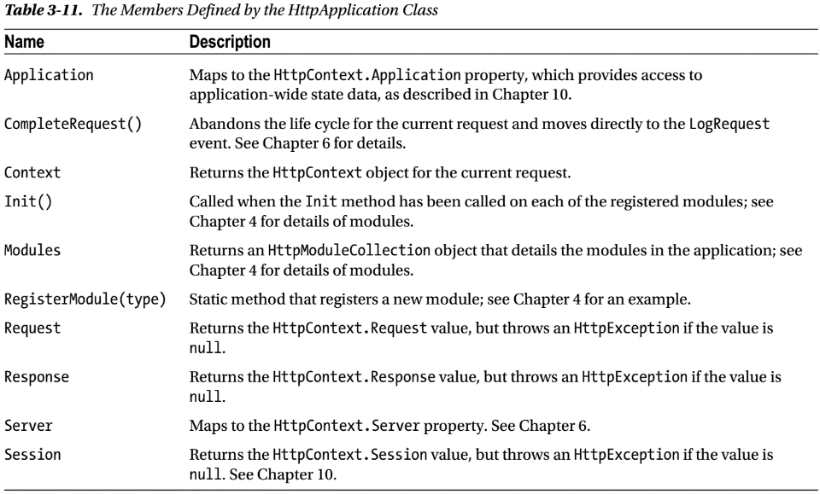
Table – 3.11

Slide 105
Handling Property Exceptions
The Request, Response, Session, and User properties all return the value of the corresponding properties from the HttpContext class, but with a wrinkle—all of these properties will throw an HttpException if the value they get from HttpContext is null.
This happens because the HttpApplication class receives notifications for two different life cycles: the application life cycle and the request life cycle.
Objects that describe a single request are not available when an instance of the global application class is being used to handle application-level events, so the HttpException is thrown if you try to access request-related properties when handling application-level notifications.
The policy of throwing an exception is harsh because it makes it hard to deal with HttpApplication objects of unknown provenance.
You can see an example of this issue in Listing 3-9, which shows changes to the global application class.

Slide 106
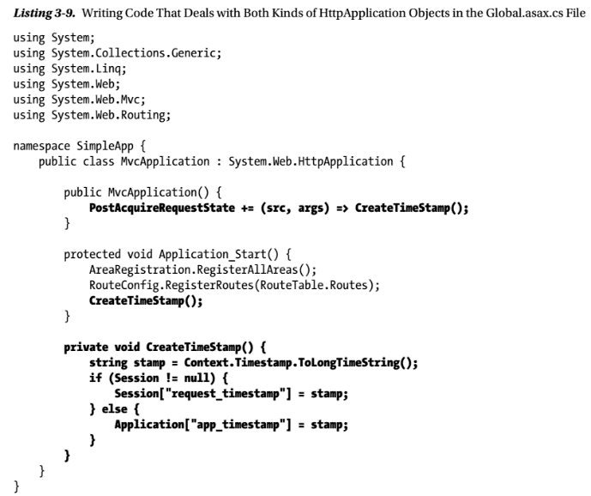
Listing 3-9

Slide 107
HttpRequest Objects
The HttpRequest object describes a single HTTP request as it is being processed.
Table 3-12 describes the HttpRequest properties that provide information about the current request.
The HttpRequest object is so frequently used that some application components, including Razor views, provide convenience properties so that you don’t have to obtain an HttpContext object just to get an instance of HttpRequest.
Table 3-13 summarizes the convenience properties that are available for HttpRequest objects.
In addition to the properties shown in Table 3-12, there are some properties that provide access to the data included in a request.
I have shown these in Table 3-14, but they are not usually used directly in MVC controllers because model binding is easier to work with. These properties are sometimes used in modules, however.

Slide 108
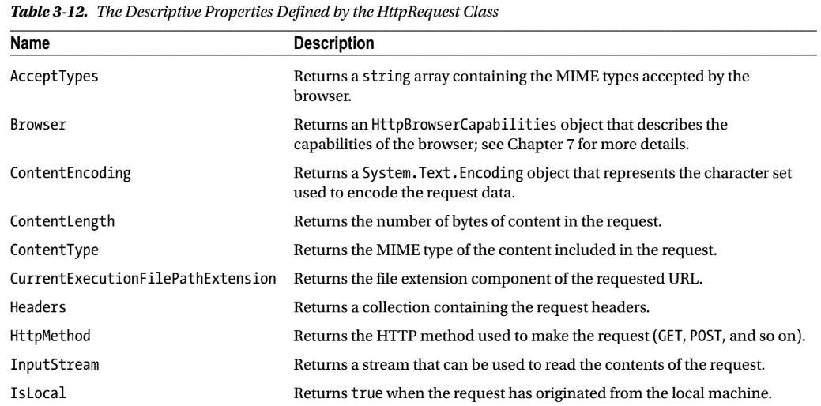
Table – 3.12

Slide 109
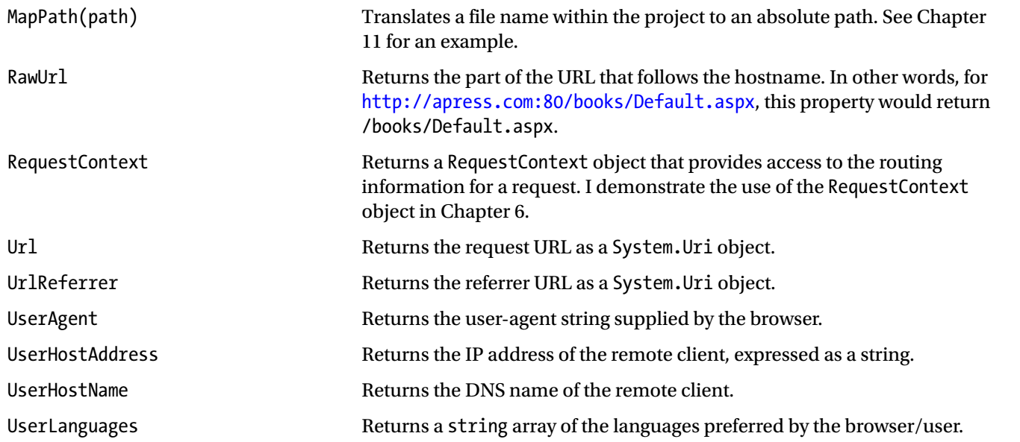
Table – 3.12 |

Slide 110
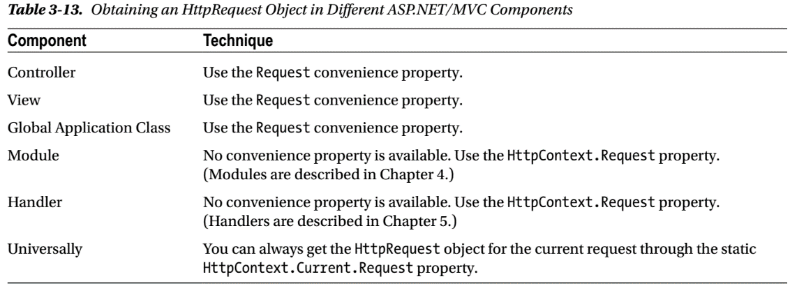
Table – 3.13

Slide 111
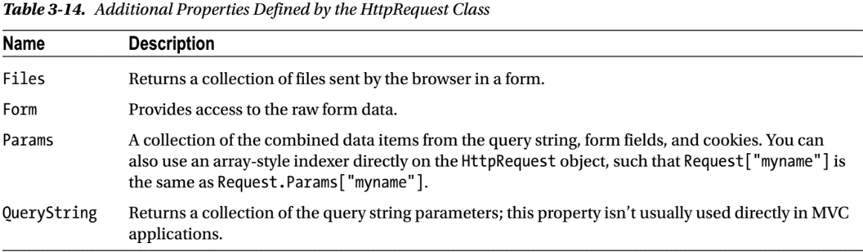
Table – 3.14

Slide 112
HttpResponse Objects
The HttpResponse object is the counterpart to HttpRequest and represents the response as it is being constructed.
It also provides methods and properties that let you customize the response, something that is rarely required when using MVC views but that can be useful when working with other components, such as modules and handlers.
Like HttpRequest, this class is essential to the way that ASP.NET processes requests and is used extensively within the MVC framework to generate the HTML (or other data) that is returned to clients.
The most important methods and properties are defined in Table 3-15.
Table 3-16 summarizes the convenience properties that are available for HttpResponse objects.

Slide 113
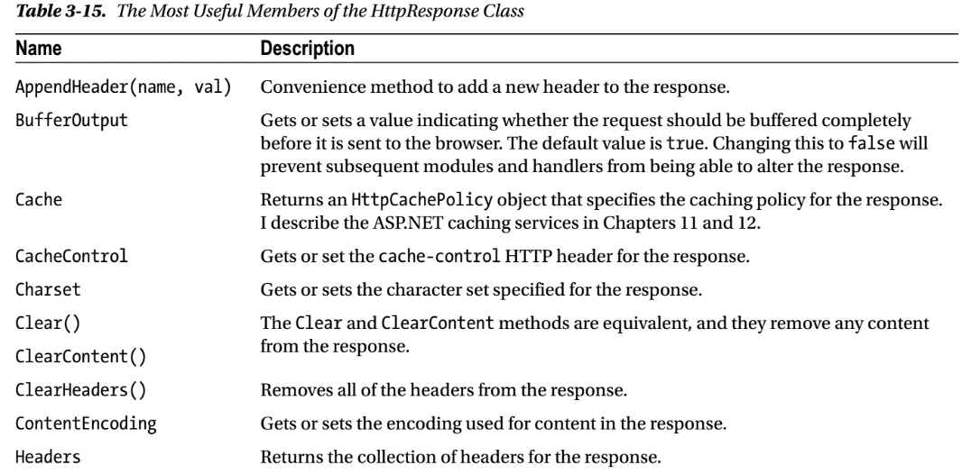
Table – 3.15

Slide 114
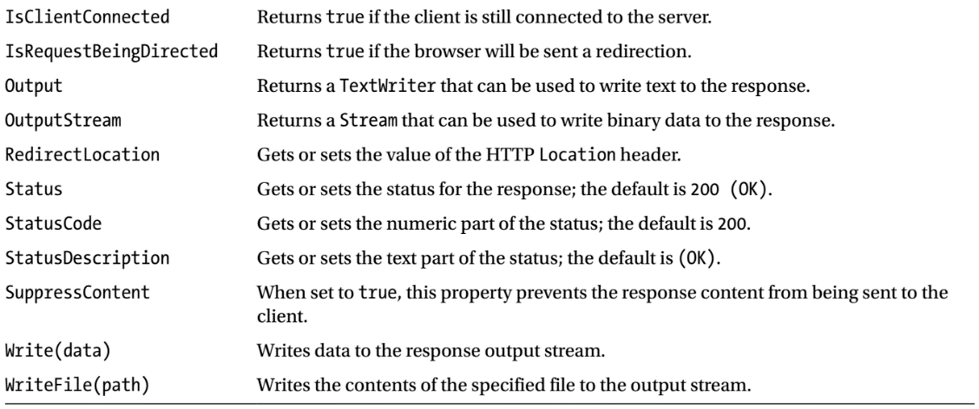
Table – 3.15 |

Slide 115
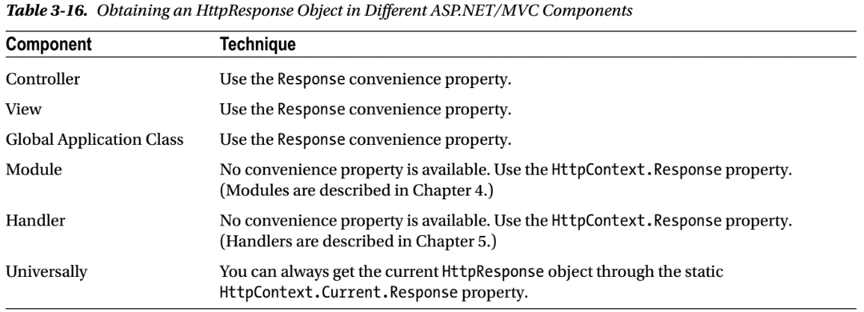
Table – 3.16

Slide 116
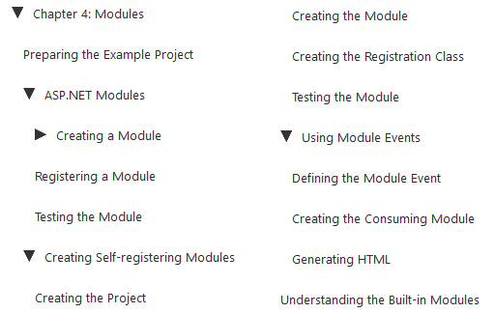
Modules

Slide 117
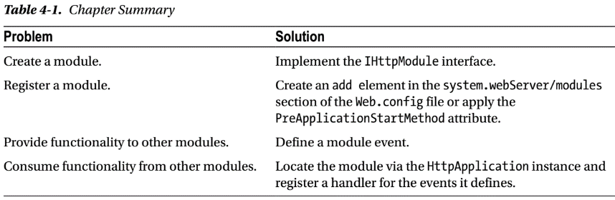
Intro
Modules are self-contained components that receive and handle life-cycle requests and which can monitor or modify a request and its response.
Not only do modules avoid a morass of code in the global application class, but they can be packaged up and used in multiple applications, providing a useful mechanism for creating reusable features for customizing or debugging the ASP.NET request handling process.

Slide 118
Preparing the Example Project

Slide 119
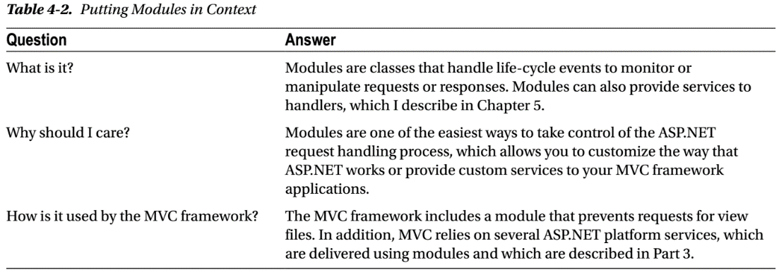
ASP.NET Modules
Table 4-2 puts modules in context.

Slide 120
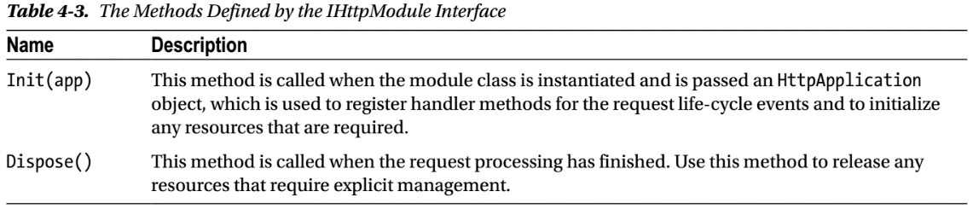
Creating a Module
Modules are classes that implement the System.Web.IHttpModule interface. The interface defines the two methods described in Table 4-3.
Consider a simple module and its usage in an MVC framework application.
Create a folder called Infrastructure where you can add supporting classes in an MVC framework project.
Add a class called TimerModule.cs to the new folder and used it to define the module shown in Listing 4-2.
This module uses the high-resolution Stopwatch timer class in the System.Diagnostics namespace to measure the elapsed time between the BeginRequest and EndRequest life-cycle events.

Slide 121

Listing 4-2

Slide 122

Setting Up the Event Handlers
Modules are instantiated when the ASP.NET framework creates an instance of the global application class.
The module Init method is invoked so that the module can prepare itself to handle requests, which usually means registering event handlers with the HttpApplication object that is passed as the method’s argument.
The Init method is called only when a module object is instantiated, which means you must use the Init method only to perform one-off configuration tasks such as setting up event handlers.
You must not perform configuration tasks that are required to process individual requests.

Slide 123

Handling the BeginRequest Event
The BeginRequest life-cycle event is the cue to start the timer.
I use the same method to handle both of the events I am interested in, which means I have to use the HttpContext.CurrentNotification property to work out which event I have received, as follows:
The src object passed to event handlers for life-cycle events is an instance of the HttpApplication class, which you can use to get an HttpContext object, but I find it easier to use the static HttpContext.Current property.
I instantiate and start a new timer if the CurrentNotification property indicates that I have received the BeginRequest event.

Slide 124

Handling the EndRequest Event
Receiving the EndRequest event tells me that the request has been marshaled through the request life cycle and the MVC framework has generated a response that will be sent to the browser.
The response has not been sent when the EndRequest event is triggered, which allows me to manipulate it through the HttpResponse context object.
In this example, I append a message to the end of the response that reports the elapsed time between the BeginRequest and EndRequest, as follows:
I use the HttpResponse.Write method to add a string to the response.
I format the string as HTML and use the Bootstrap alert and alert-success CSS classes to style the content as an inline alert box.

Slide 125

Registering a Module
Unlike the MVC framework, the ASP.NET platform doesn’t discover classes dynamically, which means you have to explicitly register a module with the ASP.NET framework before it takes effect.
Modules are registered in the Web. config file, as shown in Listing 4-3.

Slide 126
Testing the Module
All that remains is to start the application and see the effect the module has. Each time the ASP.NET framework receives an HTTP request, the TimerModule class will be sent the BeginRequest event, which starts the clock.
After the request has proceeded through its life cycle, the module is sent the EndRequest event, which stops the clock and adds the time summary to the response, as illustrated by Figure 4-2.
If you look at the HTML that has been sent to the browser, you will see how the message from the module has been added to the response:
The div element that the module adds to the response appears after the closing html tag.
This happens because the ASP.NET framework doesn’t care about the kind of data that an HTTP response contains and so there is no special support for ensuring that HTML is properly formatted.
The main part of the response is generated by the handler and additions to the response by modules either precede or follow the content that the handler generates.

Slide 127


Figure 4-2

Slide 128
Creating Self-registering Module
One of the benefits modules confer is that they can be reused across multiple projects.
A common approach to module development is to define them in a separate project from the rest of the web application so that the output from the project can be used multiple times.
Creating a module project is a simple task, except for the process of registering the modules.
You can define a fragment of XML that has to be inserted into the Web.config file, but this puts you at the mercy of the developer or administrator who sets up the web application—something that I generally like to avoid, especially when I have several modules that work together to deliver functionality.
A better approach is to create modules that register themselves automatically using an assembly attribute called PreApplicationStartMethod.
This attribute allows an assembly to define a method that is executed before the Application_Start method in the global application class is invoked, which is exactly when modules need to be registered.

Slide 129

Table 4-4

Slide 130
Creating the Project

Slide 131
Using Module Events

Slide 132
Understanding the Built-in Modules
The ASP.NET framework contains a number of built-in modules, many of which support the core platform services.
Some of these modules define events that you can handle to get fine-grained information about their activities, although for the most part, you interact with the functionality they provide through the context objects.
Lets create an example so as to
enumerate the modules
explain what each of them does, and
describe the events that some of them define.
To generate the list of modules, I have added a new action method to the Home controller, as shown in Listing 4-9.

Slide 133

5
Handlers

Slide 134

Intro
Handlers are responsible for generating the response content for an HTTP request.
Table 5-1 summarizes Handlers

Slide 135
Preparing the Example Project

Slide 136
ASP.NET Handlers

Slide 137
Creating a Handler

Slide 138
Creating Asynchronous Handlers

Slide 139
Creating Modules That Provide Services to Handlers

Slide 140
Custom Handler Factories

Slide 141

6
Disrupting the Life Cycle

Slide 142

7
Detecting Device Capabilities

Slide 143

8
Tracing Requests

Slide 144

9
Configuration

Slide 145
Intro
The first service that the ASP.NET platform provides to applications is configuration.
The configuration feature is rich and flexible and helps avoid one of the pitfalls of complex software development: hard-coding behaviors into software components.
The ASP.NET support for configuration can be adapted to suit all kinds of web applications and is worth taking the time to understand.
Table 9-1 summarizes this chapter.

Slide 146

Table 9-1

Slide 147
Preparing the Example Project
Created a new project called ConfigFiles by selecting the Empty option, and added the core MVC references.
Add Bootstrap using NuGet.
Add Home controller to the Controllers folder, the definition of which you can see in Listing 9-1.
Create a view Index.cshtml, select the Empty (without model) template, and uncheck all of the view option boxes.
You can see the content I defined in the view in Listing 9-2.
Start the application and navigate to the root URL or /Home/Index to see how the view is rendered, as shown in Figure 9-1.

Slide 148

Listing 9-1

Slide 149

Listing 9-2

Slide 150

Figure 9-1

Slide 151
ASP.NET Configuration
Aside from a few standard additions to configure a database or enable debugging, most MVC framework developers don’t give any thought to the Web.config file, which is a shame because it provides a useful set of features that configure ASP.NET and that can be consumed within application code.
Table 9-2 puts the ASP.NET configuration system into context.

Slide 152

Table 9-2

Slide 153
Understanding the Configuration Hierarchy
Most MVC framework developers only need to edit the Web.config file in the top-level of the Visual Studio project, but this is just one of a hierarchy of configuration files that ASP.NET uses.
When an application is started, ASP.NET starts at the top of the hierarchy and works its way down.
Each level in the hierarchy has a slightly narrower scope, and the overall effect is to allow lower-level configuration files to override more general settings that have been previously defined.
The application-level Web.config file—the one in the root folder of Visual Studio—is close to the bottom of the hierarchy and relies on dozens of settings that have been defined in higher-level files.
Table 9-3 summarizes the configuration files and explains how they relate to one another.
The MVC framework includes a file called web.config (with a lowercase w) in the Views folder. The file names are not case sensitive, and this is an example of a folder-level Web.config file as described in the table.

Slide 154
Understanding the Configuration Hierarchy |
ASP.NET starts with the Machine.config file, which is at the top of the hierarchy to get the starting point for the configuration and then moves to the second-level of the hierarchy and processes the ApplicationHost.config and global Web.config files.
New settings are added to form a merged configuration, and values for existing settings are replaced.
This process continues down the hierarchy until the app-level Web.config file is reached, and elements are used to expand the merged configuration or replace existing configuration values.
Finally, the location elements and the folder-level Web.config files are processed to create specific configurations for parts of the application.
Figure 9-2 shows the hierarchy of files as they are processed.
Although the configuration is spread throughout multiple files, the overall effect is a consistent configuration where settings are defined for every application at the global level and then progressively refined in the site, application, and folder-level files.
This is why something as complex as an MVC framework application needs only a few lines of settings in the Web.config file: Hundreds of other settings are defined further up the hierarchy.

Slide 155
Understanding the Configuration Hierarchy ||
If any of the files are missing, ASP.NET skips to the next level in the hierarchy.
The global files define the structure that later files use to define configuration settings as well as their default values.
One of the reasons that developers work with the application-level Web.config file is that the files higher up in the hierarchy cannot be edited, something that is almost always the case for hosting and cloud platforms and frequently true for IIS servers running in private data centers as well.
The ASP.NET platform caches the configuration data after it processes the hierarchy of files to improve performance.
However, the configuration files are monitored, and any changes cause the application to be restarted, which can cause any state data to be lost and interrupt service to users.
For this reason, it is important you don’t modify the configuration files for a production system while the application is running.
During development you will sometimes need to change the global configuration files to re-create the settings that you will encounter in production. You can find the Machine.config and global Web.config files in the following folder:

Slide 156
Understanding the Configuration Hierarchy |||
You may have a slightly different path if you are using a later version of .NET or have installed Windows into a nonstandard location. You can find the ApplicationHost.config file used by IIS Express in the following folder, where <user> is replaced by the name of the current user:

Slide 157

Table 9-3

Slide 158

Table 9-3 |

Slide 159

Figure 9-2

Slide 160
NOTE
I have included the site-level Web.config file for completeness, but it is specific to IIS. IIS is still widely used, but there is a substantial shift toward cloud deployment and the use of other servers using the OWIN API.
It is recommended that you don’t use IIS sites and that you install each application in isolation because it makes it easier to move between deployment models. Instead, use application-level Web.config files.

Slide 161
Working with Basic Configuration Data
The configuration file system allows you to define settings for your application in different ways ranging from simple and generic key-value pairs to complex custom settings that are completely tailored to the needs of one application.
Table 9-4 puts basic configuration data into context.
Access to configuration data is provided through the WebConfigurationManager class, defined in the System.Web.Configuration namespace.
The WebConfigurationManager class makes it easy to work with the configuration system—but there are some oddities.
There are several useful static members of the WebConfigurationManager class, as described in Table 9-5.
The classes that ASP.NET provides for obtaining configuration information also allow changes to be made to the configuration.

Slide 162

Table 9-4

Slide 163

Table 9-5

Slide 164
Using Application Settings
Application settings are simple key-value pairs and are the easiest way to extend the configuration to define values that are specific to an application.
Listing 9-3 shows the application settings that I added to the application-level Web.config file (the one that is at the root level in the Visual Studio project).

Slide 165

Listing 9-3

Slide 166
Grouping Settings Together

Slide 167
Overriding Configuration Settings

Slide 168
Navigating the ASP.NET Configuration Elements

Slide 169

10
State Data

Slide 170

Intro
The two services that the ASP.NET platform provides for creating stateful data: application state and session state.
These features are easy to use, but they require forethought and caution to avoid serious performance penalties.

Slide 171
Application State Data
Application state data is common to all components in the application and is shared between all requests.
The main purpose of application state is to store data or objects that you need frequently and that are too resource-expensive or time-consuming to create for every use.
Application state can improve the performance of an application, but it is easy to create the opposite effect and slow everything down instead.

Slide 172

Application State in Context

Slide 173
Using Application State
Application state is implemented by the HttpApplicationState class, which is defined in the System.Web namespace.
An instance of the HttpApplicationState class is available through the HttpContext.Application property.
The HttpApplicationState class defines the properties and methods shown in Table 10-3.
The HttpApplicationState class is a collection of key-value pairs stored in memory and shared across the application.
The collection can be modified when the application is running, and the methods that it defines are thread-safe to prevent multiple updates from colliding when requests are being processed concurrently.

Slide 174

Table 10-3

Slide 175
Sessions and Session State Data

Slide 176
Configuring Sessions and Session State

Slide 177

Caching Data
11

Slide 178

Caching Content
12

Slide 179

13
Getting Started with Identity

